Slide 1


Lesson 15 Around Liverpool
UNIT 3

Slide 2
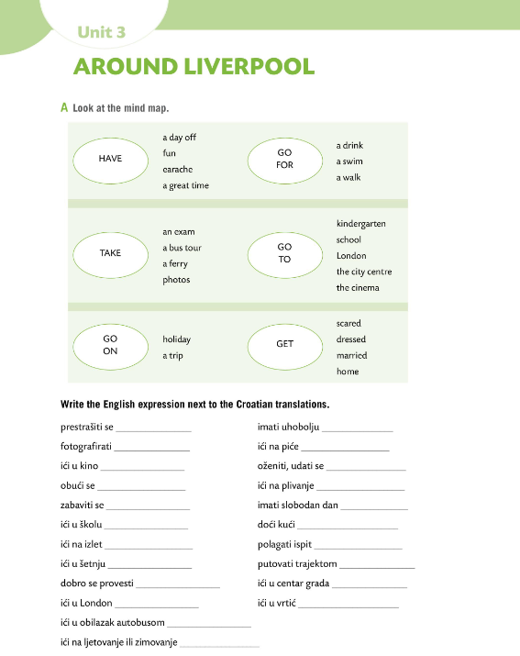

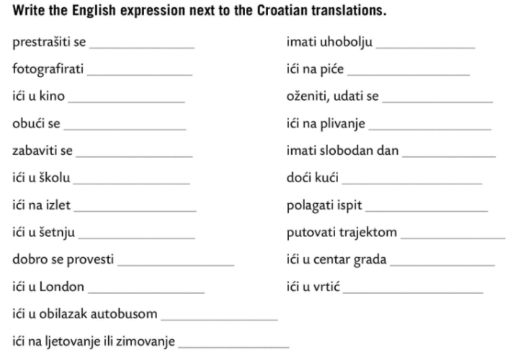
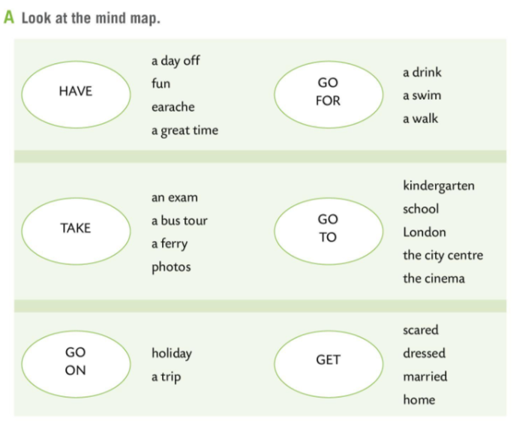
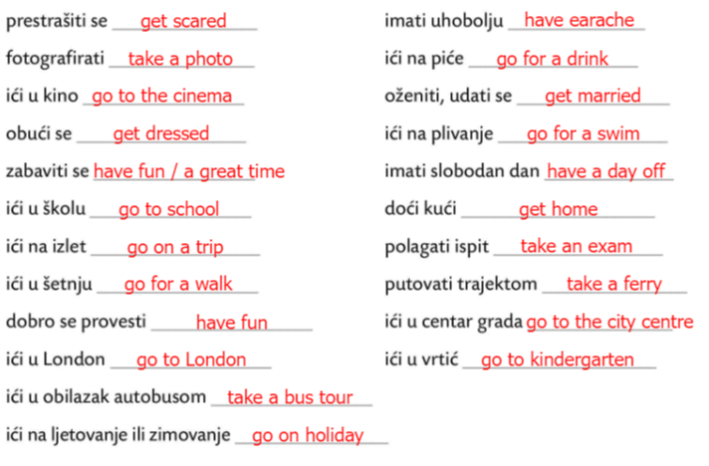
Workbook page 76.
Look at the mind map in Task A.
Write the English expression next to the Croatian translations.
Check.
Work in pairs. Person A says the Croatian translation. Person B says the English expression. Swap roles.
What is the past form of the verbs in the mind map?

Slide 3
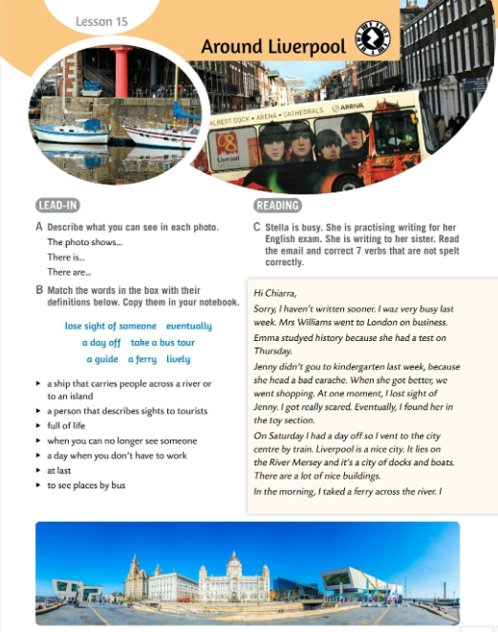
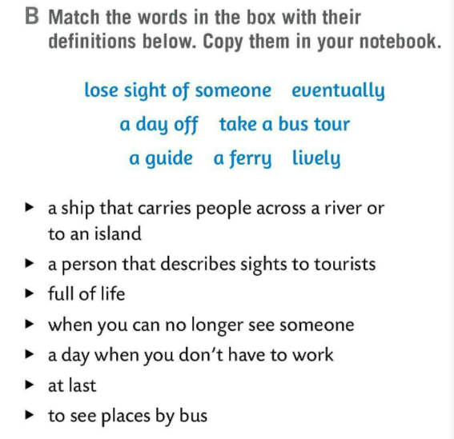
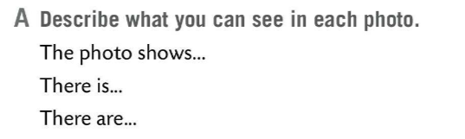
Describe what you can see in each photo. Look at Task A.
Match the words in the box with their definitions below. Copy them.
Check.
a ferry
Translate the words from Task B.
a ferry – trajekt
a guide – vodič
lively – živahan
lose sight of someone – izgubiti koga iz vida
a day off – slobodan dan
eventually – konačno
take a bus tour – razgledavanje
a guide
lively
lose sight of someone
a day off
eventually
take a bus tour

Slide 4
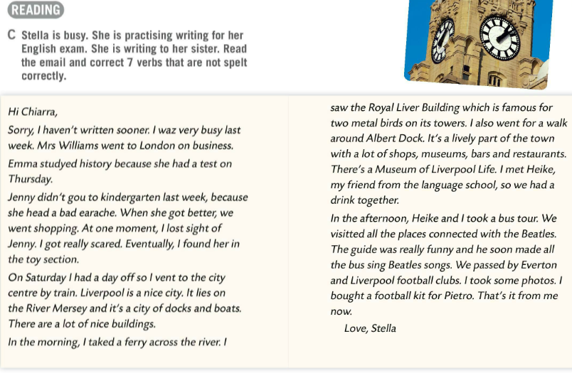
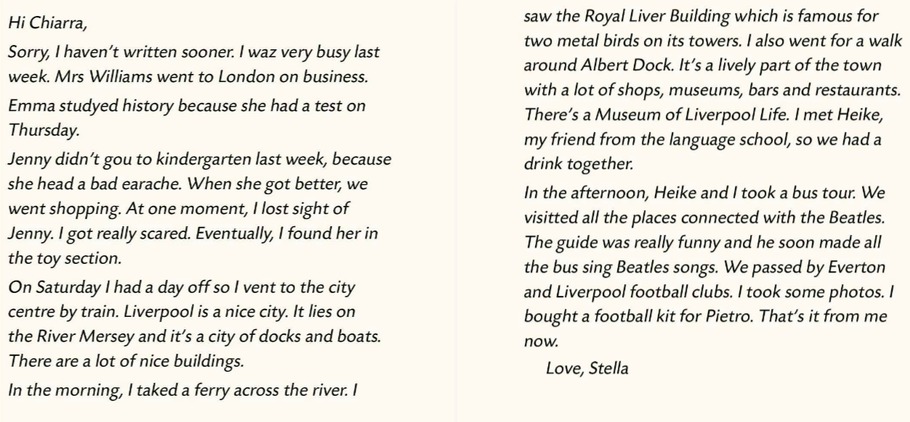
Stella is busy. She is practising writing for her English exam. She is writing to her sister.
Read the email and correct 7 verbs that are not spelt correctly.
was
Check.
studied
go
had
visited
went
took

Slide 5
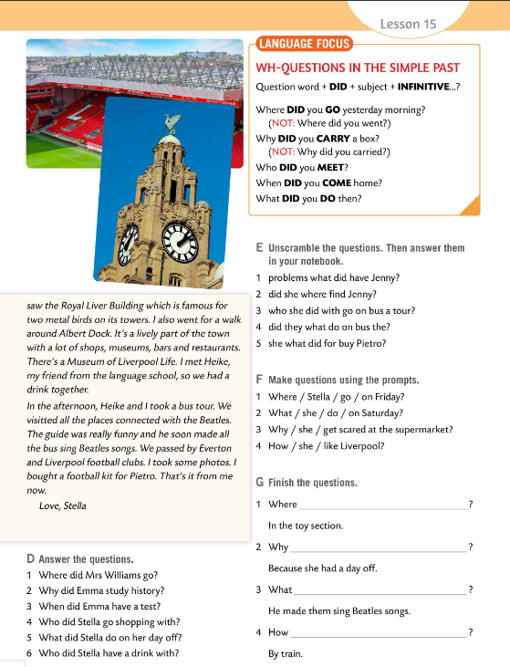
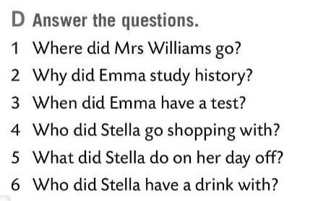
Answer the question in Task D.
Check.
1 Mrs Williams went to London on business.
2 Emma studied history because she had a test.
3 Emma had a test on Thursday.
4 Stella went shopping with Jenny.
5 Stella went to the city centre.
6 Stella had a drink with Marie.

Slide 6
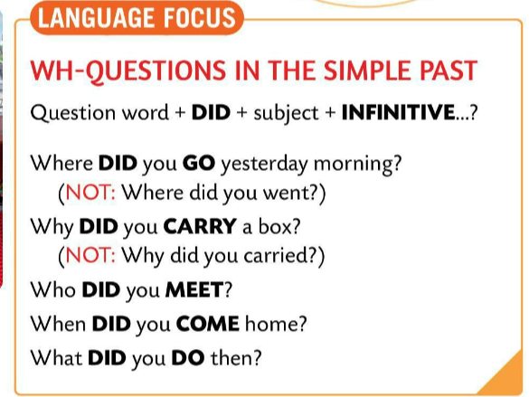
LANGUAGE FOCUS
WH- questions
Where did you go yesterday?
Why did you come there?
Who did you meet?
What did you watch on TV yesterday?
QUESTION WORD + DID + SUBJECT + INFINITIVE

Slide 7
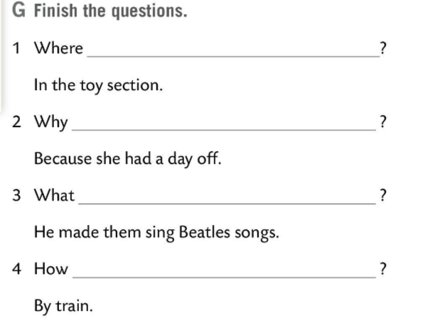
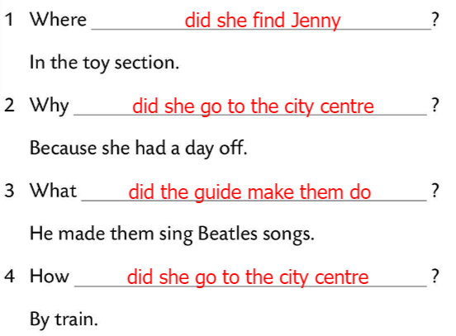
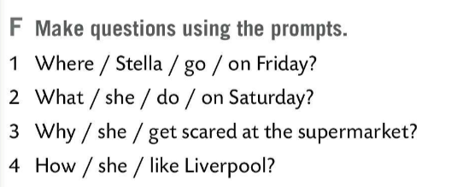
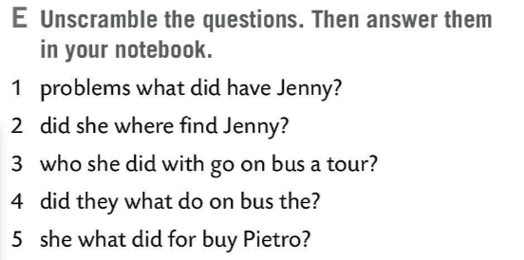
Unscramble the questions. Write the answers.
Check.
1 What problems did Jenny have?
Jenny had a bad earache.
2 Where did she find Jenny?
She found Jenny in the toy section.
3 Who did she go on a bus tour with?
She went on a bus tour with Heike.
4 What did they do on the bus?
They sang the Beatles songs.
5 What did she buy for Pietro?
She bought a football kit for Pietro.
Where did Stella go on Friday? She went to Tesco’s.
What did she do on Saturday? She went to the city centre and went sightseeing.
Why did she get scared at the supermarkert? Because she lost sight of Jenny.
How did she like Liverpool? She liked it and thinks it’s a nice city.
Make questions using prompts in Task F.
Finish the questions in Task G.
Check.

Slide 8
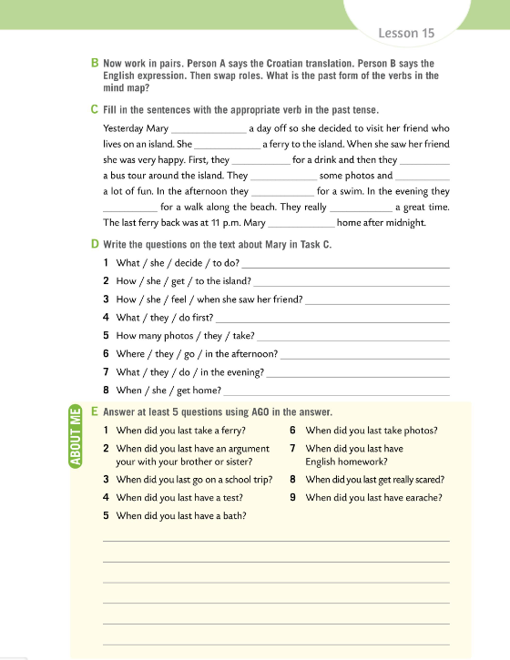
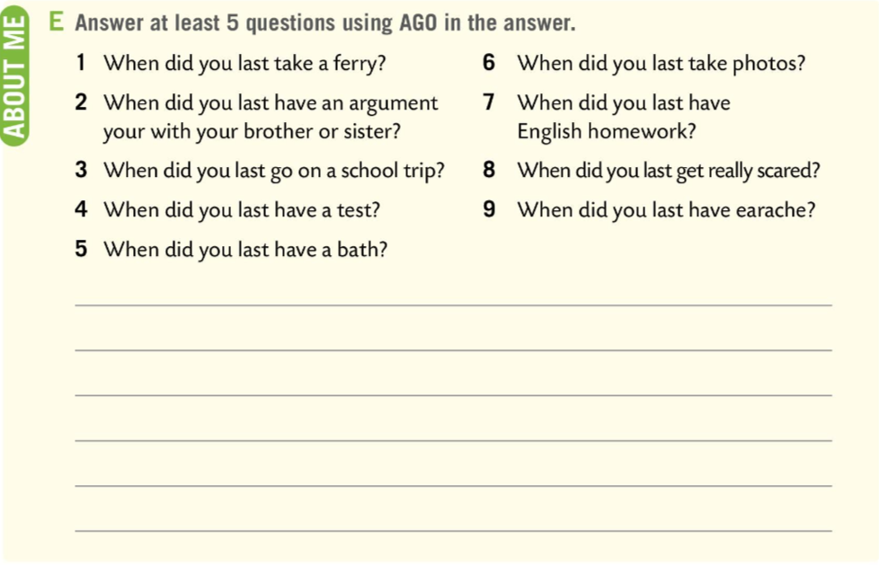
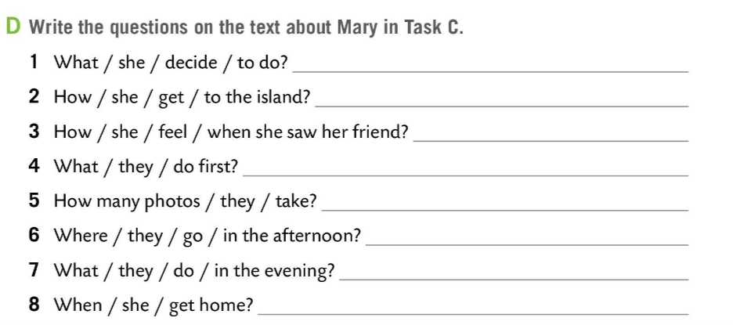
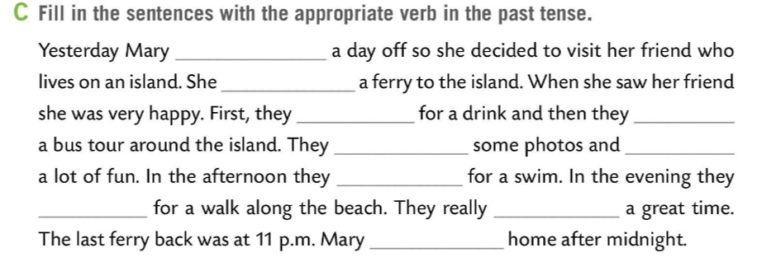
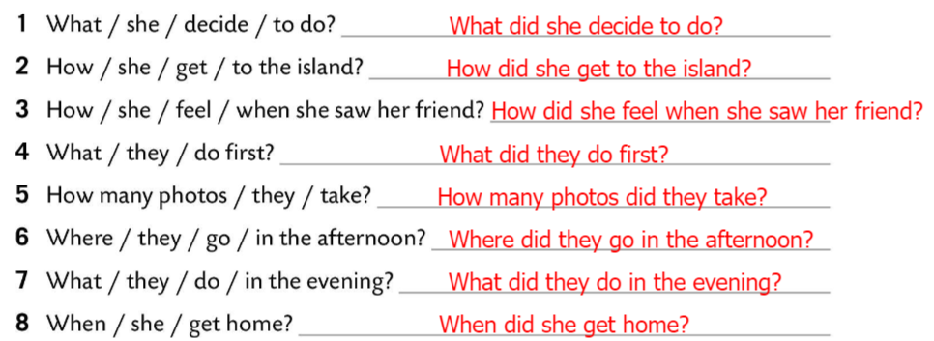
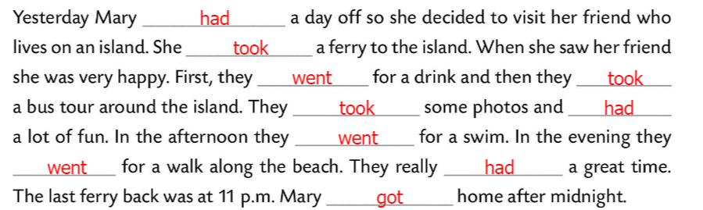
Workbook page 77.
Fill in the sentences with the appropriate verb in the past tense.
Check.
Do Task C. Write the questions about Mary.
Check.
Answer at least 5 questions using AGO in the answer.
Share your answers.

Slide 9
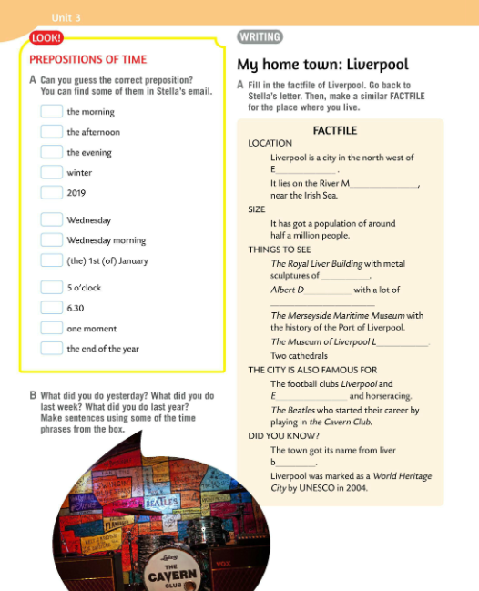
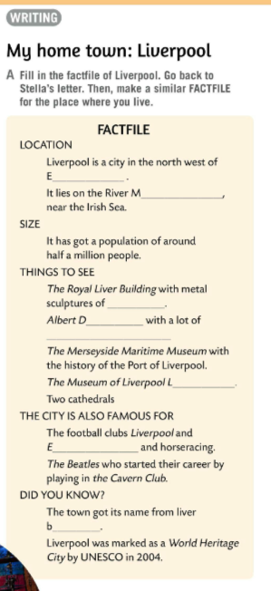
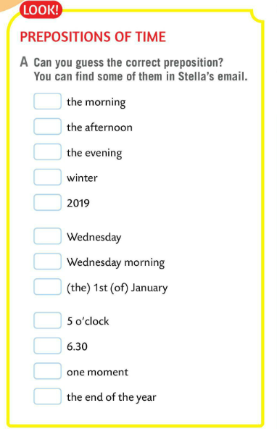
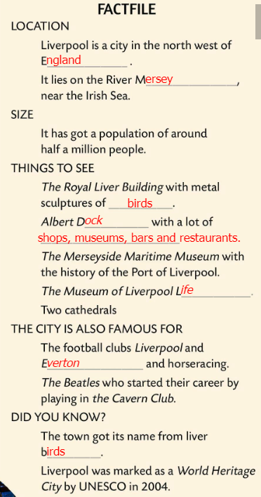
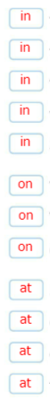
Can you guess the correct preposition in Task A? Find some of them in Stella’s email.
Check.
What did you do yesterday?
What did you do last week?
What did you do last year?
Make sentences using some of the time phrases from the box. Check in class.
Fill in the factfile of Liverpool. Go back to Stella’s letter.
Make a similar FACTFILE for a place where you live.
Check.

Slide 10
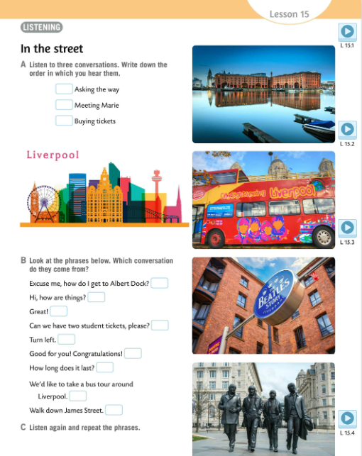

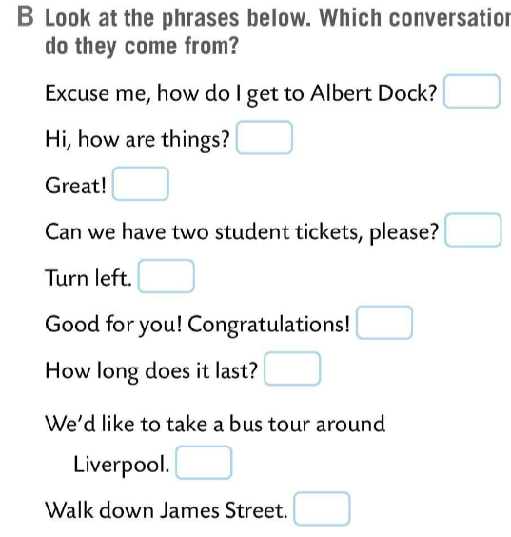
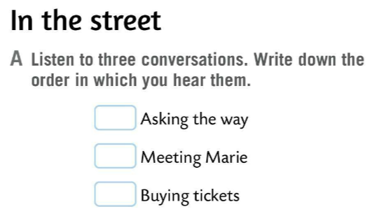
Listen to three conversations in Task A. Write down the order in which you hear them.
Check.
3
1
Look at the phrases in Task B. Which conversation do they come from?
1
2
Listen and check.
3
3
1
1
2
Listen and repeat the phrases.
2
2
Revise prepositions of time with this game. Play in two teams.
https://wordwall.net/play/511/129/112
3

Slide 11
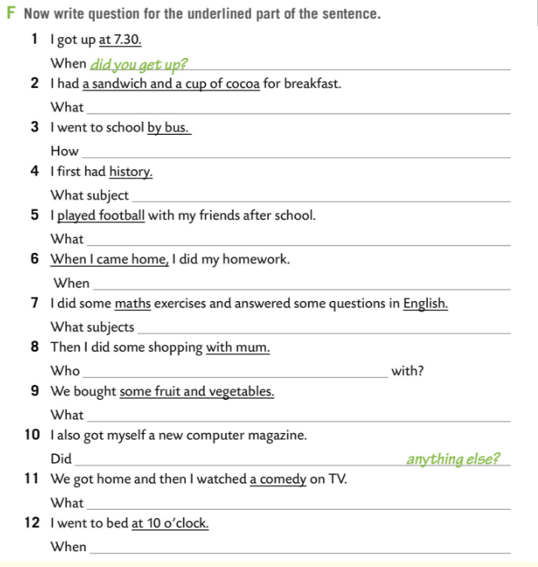
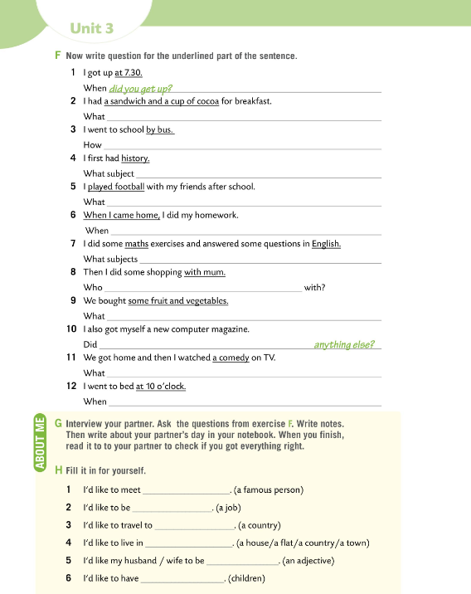
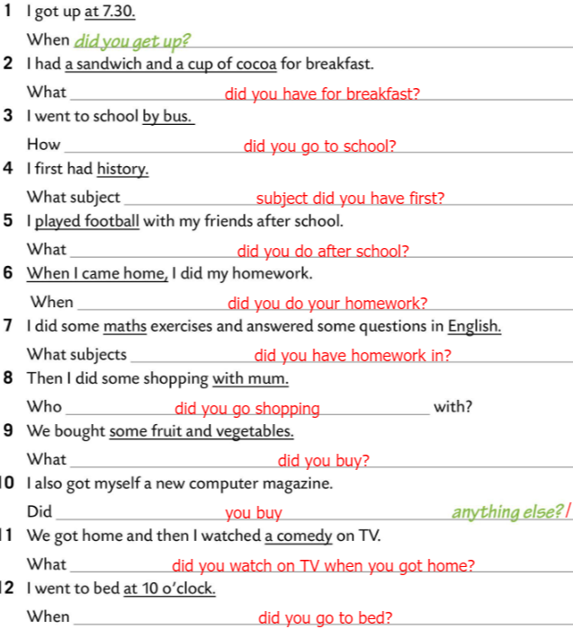
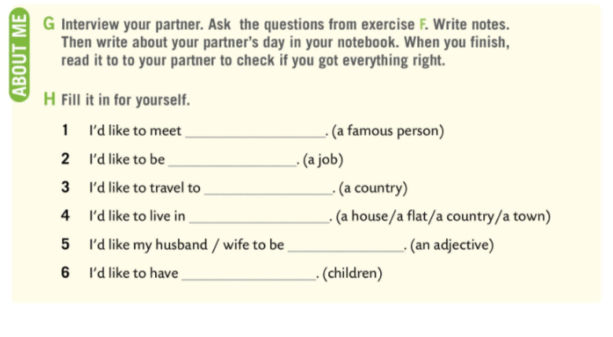
Workbook page 78.
Write questions for the underlined part of the sentence in Task F.
Check.
Interview your partner. Ask the questions from exercise F.
Write notes.
Write about your partner’s day in your notebook.
When you finish, read it to your partner to check if you got everything right.
Fill in task H for yourself.
Check.

